Slide 1
Zoro assistant
Dr: esraa afify
Eng : Mostafa

Slide 2
Team member
Adham Mahmoud 205014
Yousef Mohamed 205016
Ahmed tarek 205043

Slide 3
Introduction
This project involves sentiment analysis on a dataset of reviews using Natural Language Processing (NLP) techniques. The dataset is loaded from a CSV file, and the 'Review' column is extracted for analysis. Text preprocessing is performed by selecting a subset of reviews, applying stemming using the PorterStemmer algorithm, and preparing the text for feature extraction. Features are extracted using CountVectorizer and TfidfVectorizer, which convert the text data into numerical representations. The dataset is split into training and testing sets, and a Gaussian Naive Bayes classifier is trained on the training data. The model's performance is evaluated using a confusion matrix and accuracy score. Overall, this project showcases the application of NLP techniques and machine learning algorithms to analyze and predict sentiment in reviews

Slide 4
┌─────────────────┐
│ Import Data
└─────────────────┘ pipeline
│
▼
┌─────────────────┐
│ Preprocessing
└─────────────────┘
│
▼
┌─────────────────┐
│ Feature Extraction
└─────────────────┘
│
▼
┌─────────────────┐
│ Train Model
└─────────────────┘
│
▼
┌─────────────────┐
│ Test & Evaluate
└─────────────────┘

Slide 5
.
Import Data:
Import the required libraries.
Read the dataset from 'D:/JOU/NLP/Dataset.csv' using pd.read_csv().
Assign the 'Review' column to “d”.
Preprocessing:
Create an empty list “text “.
Iterate over “z” (first 20 elements of “d”):
Append each element to “text”.
Perform stemming using “PorterStemmer” from “nltk.stem”.
Feature Extraction:
Initialize “CountVectorizer “as a” vectorizer”.
Fit vectorizer with text data.
Transform text into features using “vectorizer”.
Create a DataFrame “dr”with the feature array and column names.

Slide 6
Train Model:
Initialize TfidfVectorizer as vectorizer2.
Fit vectorizer2 with text data.
Transform text into features using vectorizer2.
Create a DataFrame X with the feature array and column names.
Extract the 'Liked' column from dataframe1 as y.
Split the dataset into training and testing sets using train_test_split().
Initialize the Gaussian Naive Bayes classifier as classifier.
Fit the classifier with the training data.

Slide 7
Test & Evaluate:
Predict the labels for the testing set using the trained classifier.
Create a confusion matrix using confusion_matrix().
Calculate the accuracy score using accuracy_score().

Slide 8
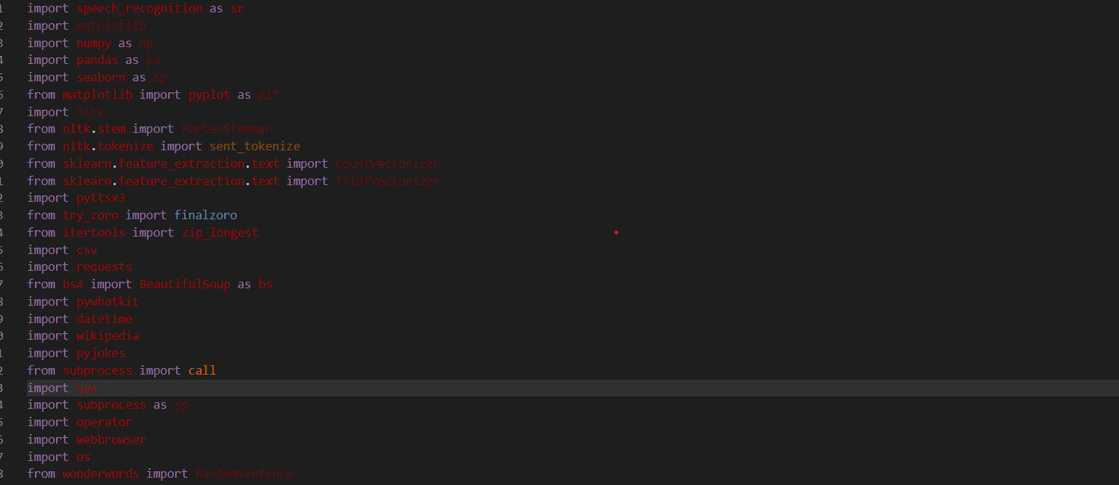
import the main libraries

Slide 9
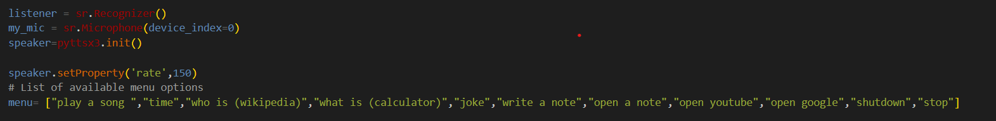
Set objects to work with it

Slide 10
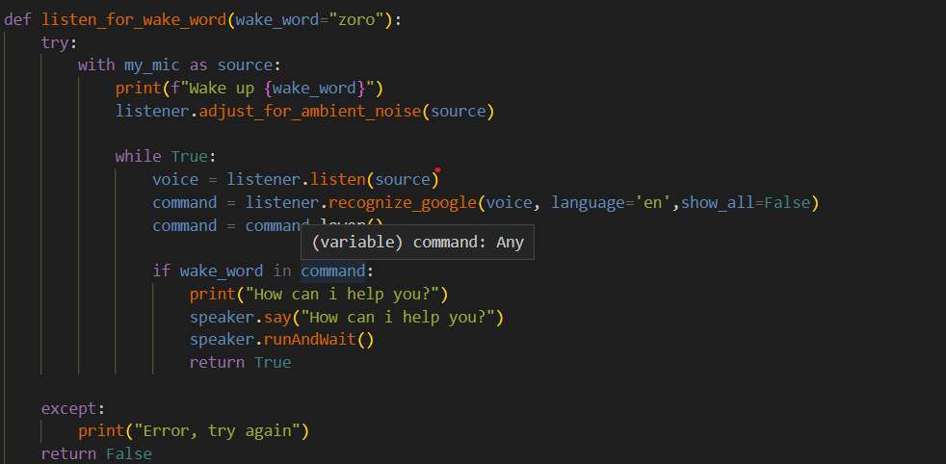
Check if the wake word is called

Slide 11
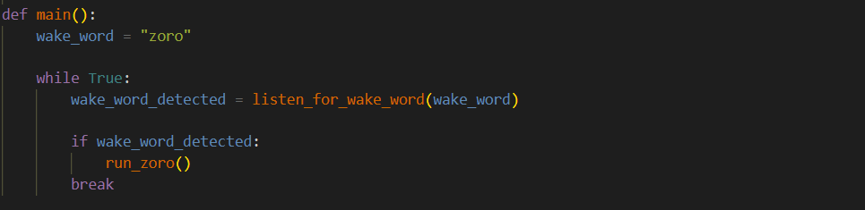
Main function to run the code

Slide 12
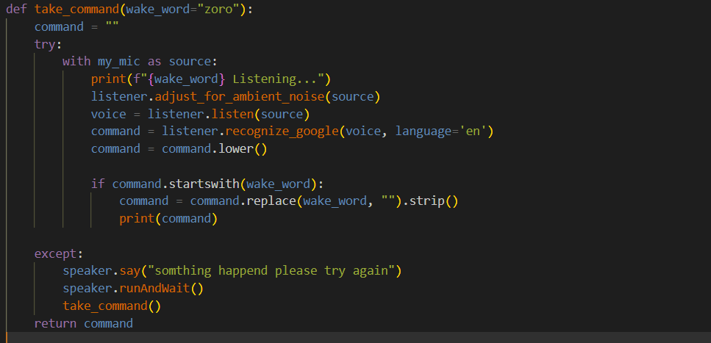
Take the actual command

Slide 13
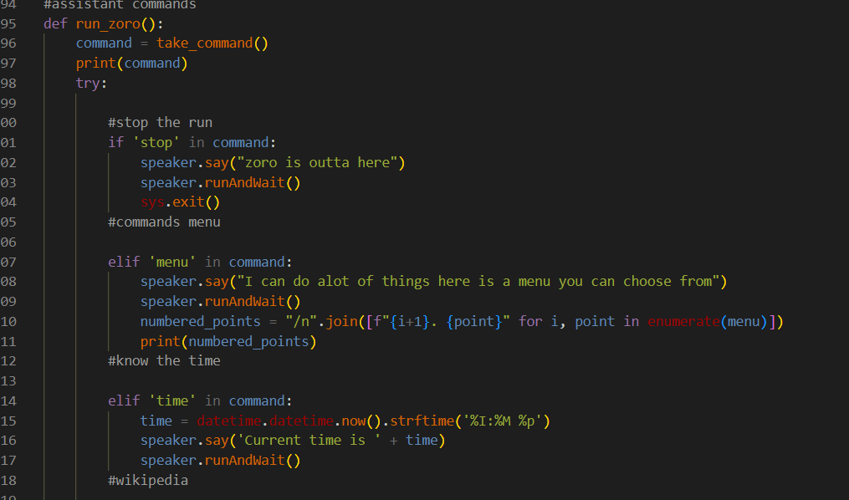
Assistant commands

Slide 14
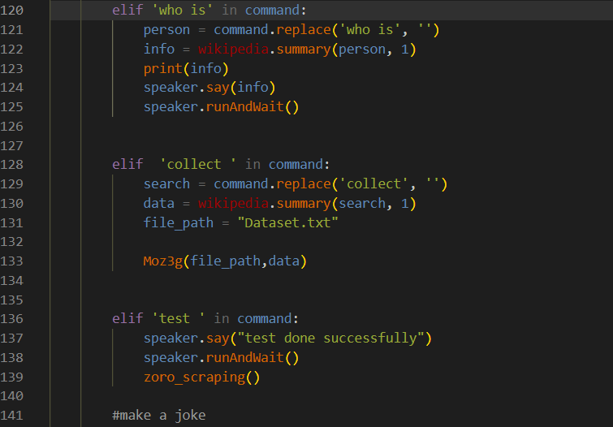
More commands for assistant

Slide 15
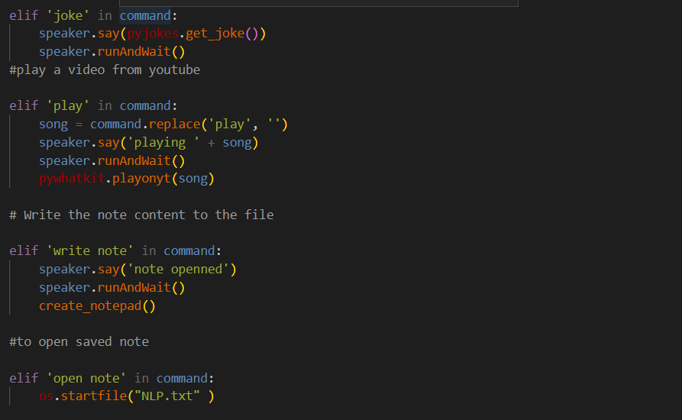
Make a joke, play a song, write in a notepad

Slide 16
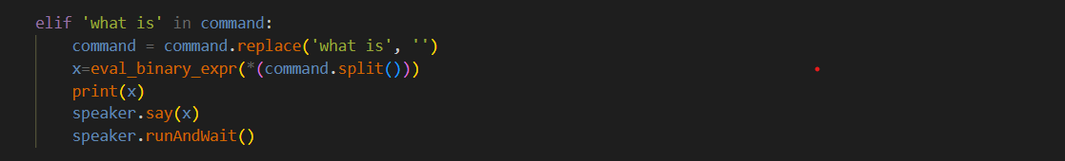
Calculator (+,-,*,/,mod, xor)

Slide 17
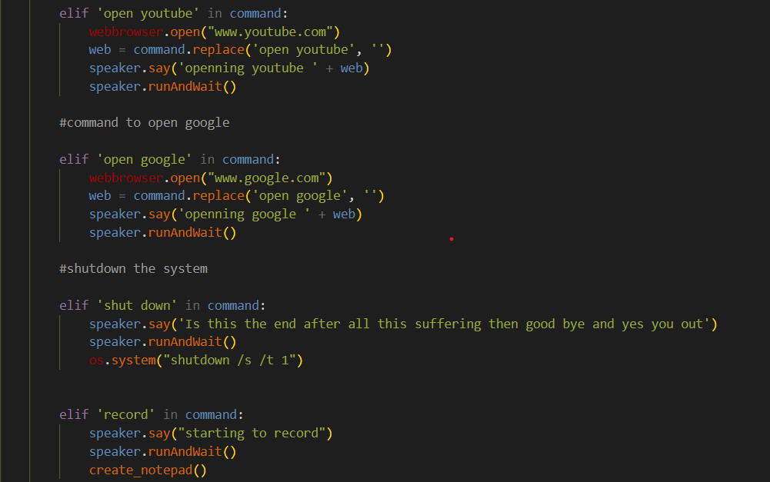
Open YouTube, open Google

Slide 18
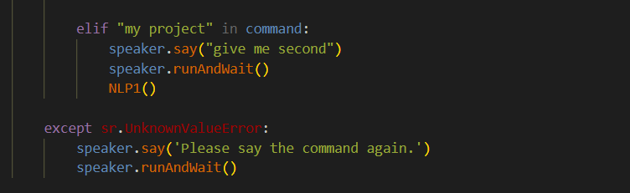
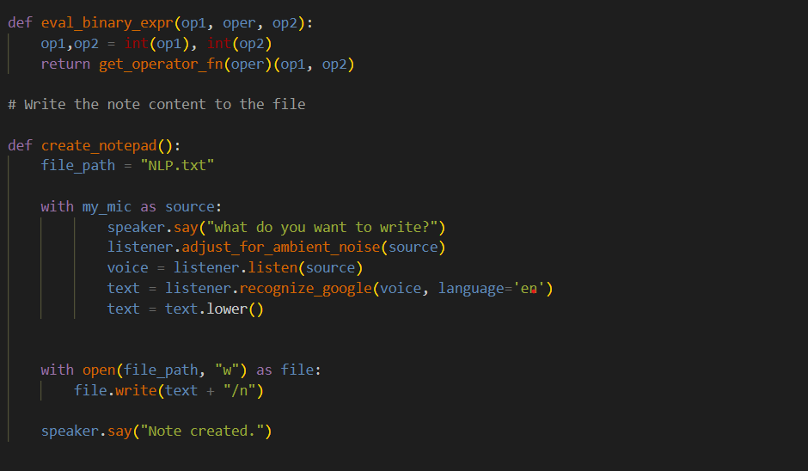
My project function
Handling error
Create a new notepad

Slide 19
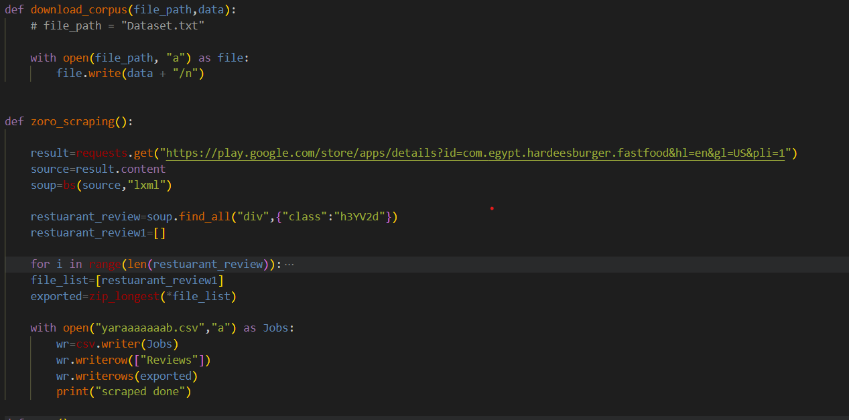
Download corpus

Slide 20
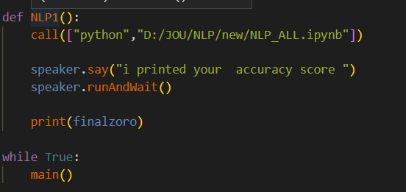
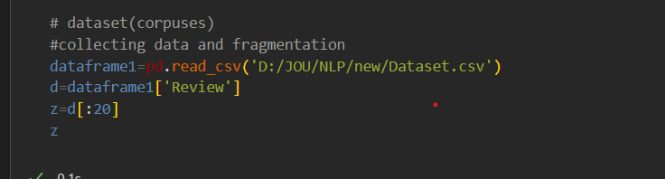
NLP function
Collecting data and fragmentation and displaying it

Slide 21
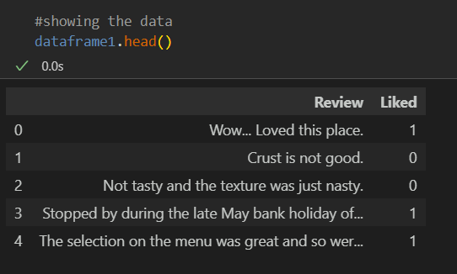
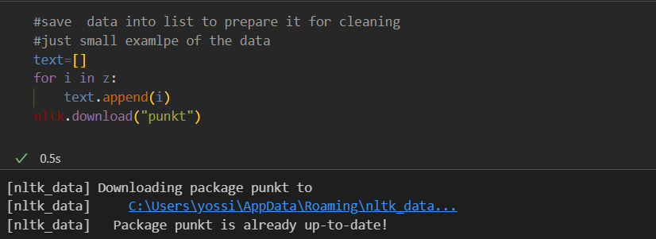
Display the 5-row form data_frame

Slide 22
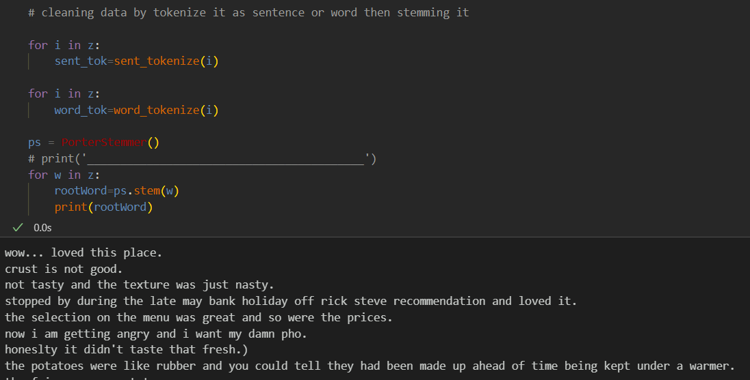
Cleaning data by tokenizing it

Slide 23
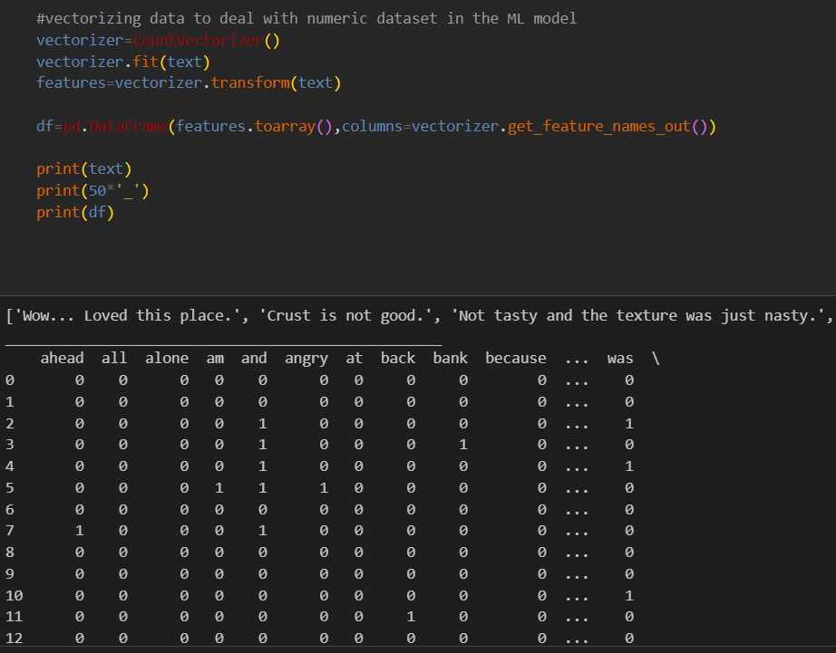
Vectorizing data

Slide 24
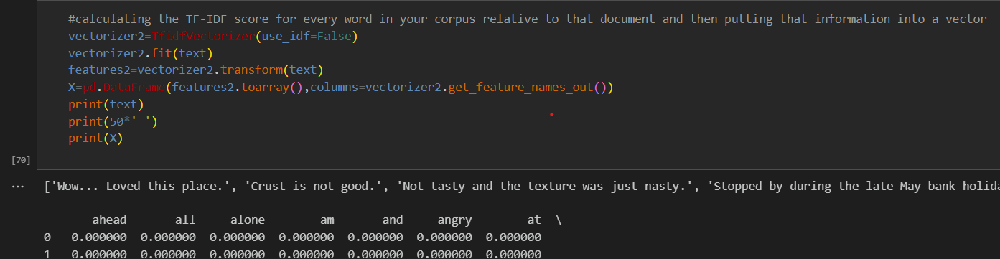
Function TF-TDF

Slide 25
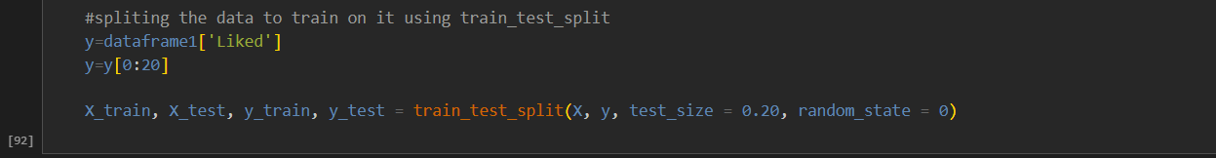
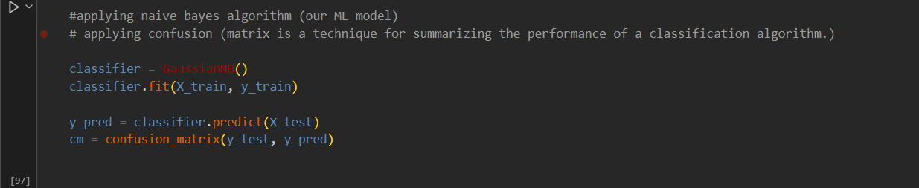
Training Model
Naïve bayes algorithm

Slide 26
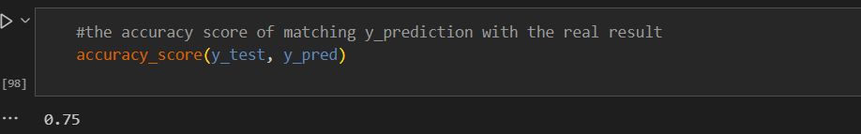
Accuracy

